Slide 1
Engagement
LIKES ACTION
By: Vaughn Gooding, Seamus Crowley, Uyen Nguyen, Tyler Farrell

Slide 2
Strategy
Making National Local
Entice
Enter
College Student Partnership
Media Strategy Plan
Engage
Exit
Extend

Slide 3
826 College Partnerships
826 NYC
826 Boston
826 Los Angeles

Slide 4
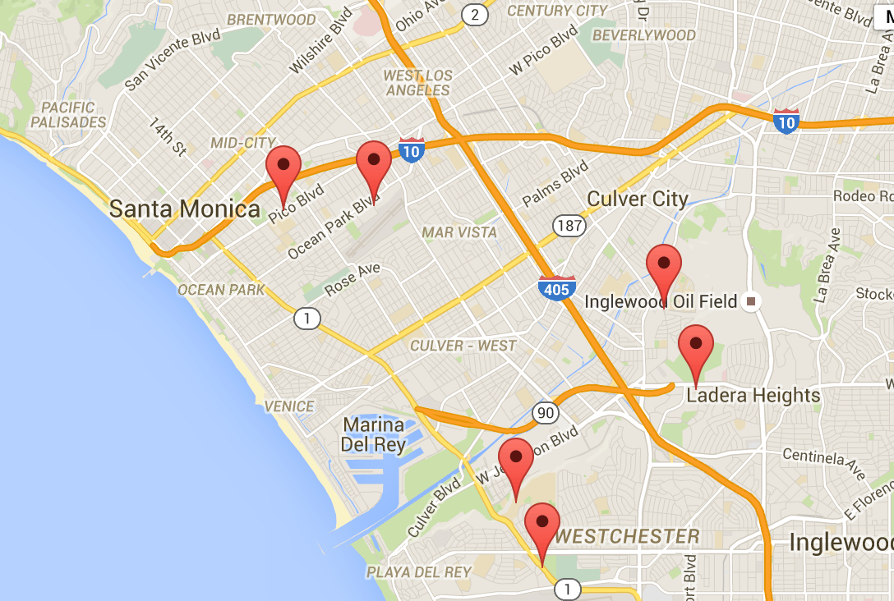
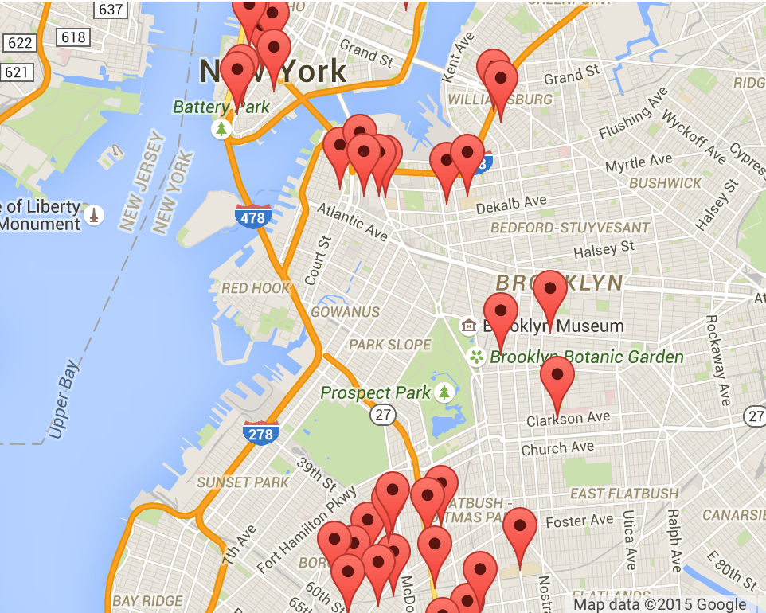
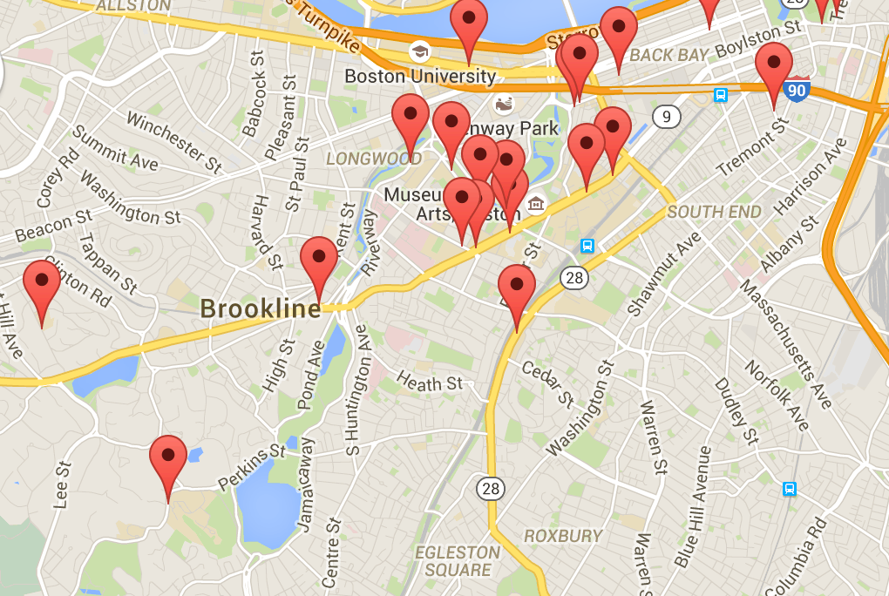

Slide 6
Media Strategy
Making National Local
Followers
Donors
Redesigning Homepage
Facebook HONY Style
Email Confirmation With
Story
How Does Your Donation Help Video

Slide 7
Redesigning Homepage
“It is more challenging to get fundraising at a national level”- Ninive Calegari, Co-Founder of 826 National
Making National Local

Slide 8
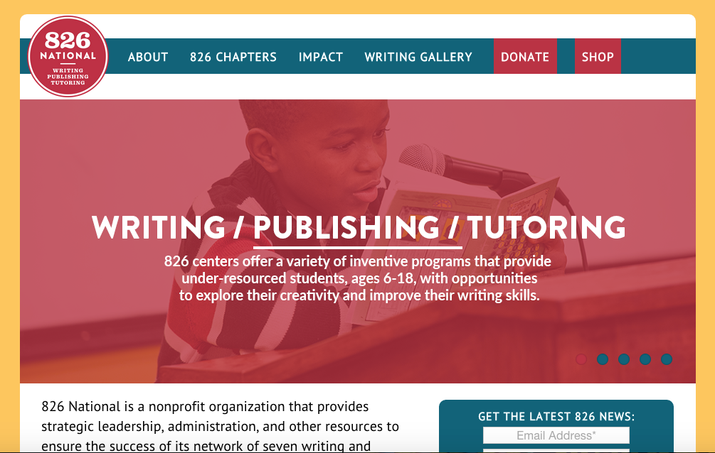

Slide 9
Helping Kids Find their Inner Hero
How Does Your Donation Help?

Slide 10
How Does Your Donation Help?
“Give donors access to the work so they feel connected to the world and part of the experience”
-Bob Taylor, Shakespeare
“Donors want a face to face ask”
-Mindy Carbajal, Executive Director at Boys and Girls Club of North Tahoe

Slide 11
Helping Kids Find their Inner Hero
How Does Your Donation Help?

Slide 12
Facebook HONY Style
“People need to feel connected to those stories”
-Danielle Rees
“Donating on a personal level is more fulfilling”
-John Morrison, 23

Slide 13
Helping Kids Find their Inner Hero
How Does Your Donation Help?

Slide 14
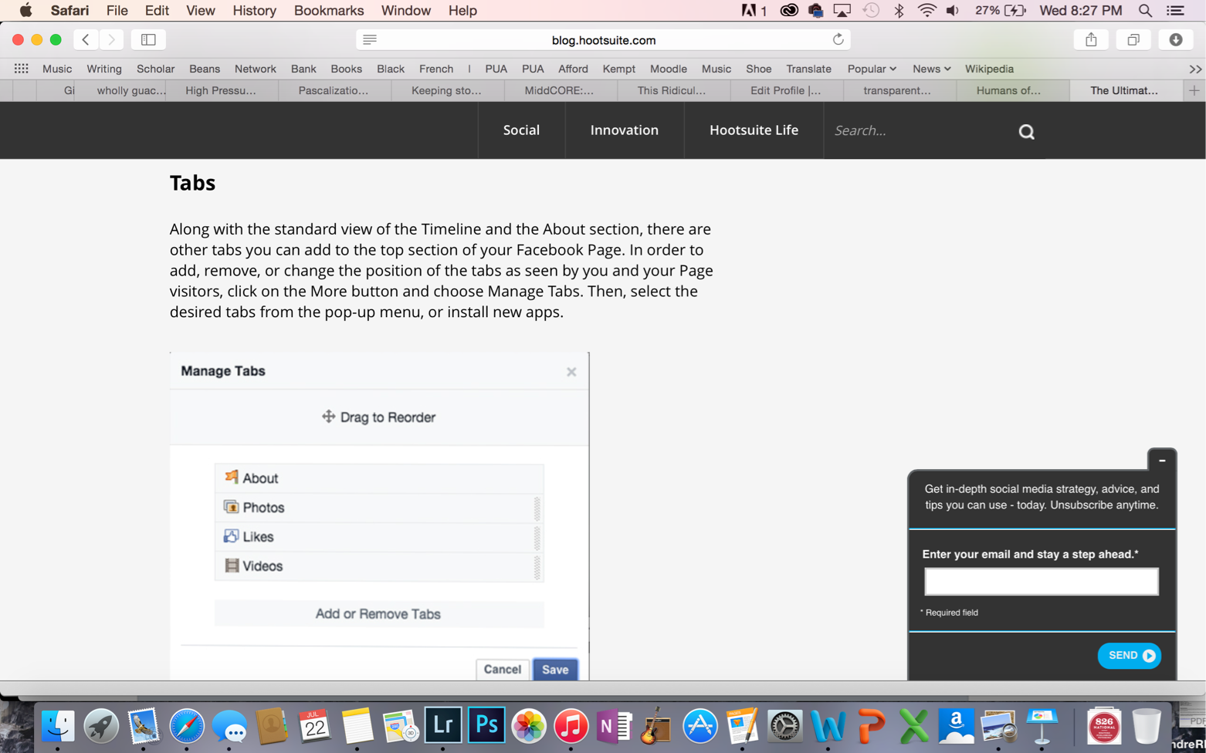
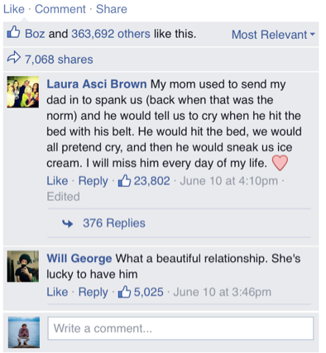

Slide 15
How Does Your Donation Help?
"for 18$/month, you’ll feed and protect animals from their abusers”
-SPCA
“for 50 cents a day you’ll help feed a child and give them critical help to survive” - UNICEF

Slide 16
Linked’IN

Slide 17
Helping Kids Find their Inner Hero
How Does Your Donation Help?

Slide 18
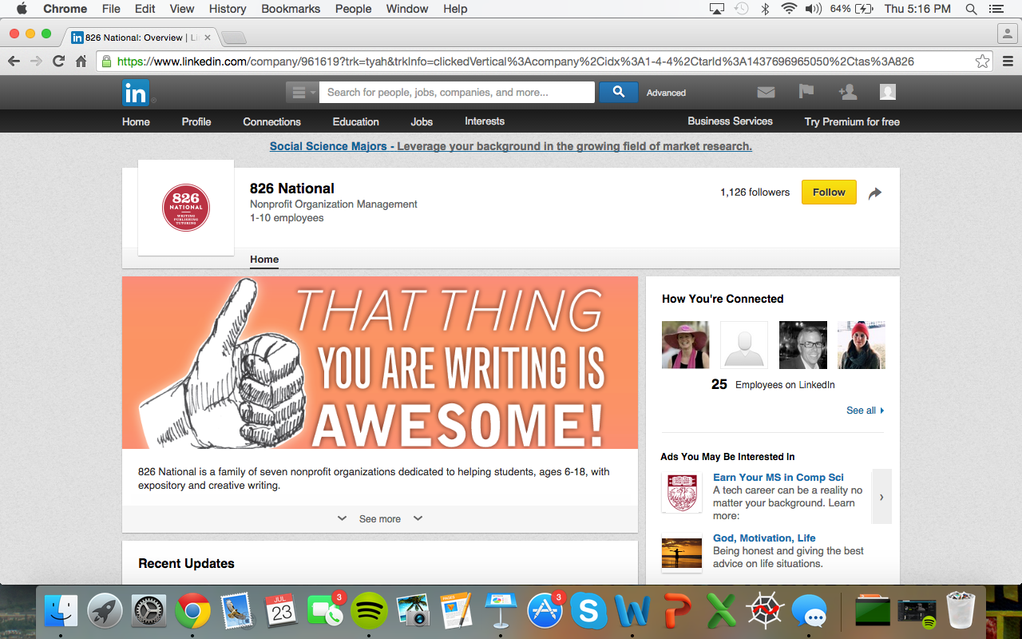

Slide 20
